Slide 1
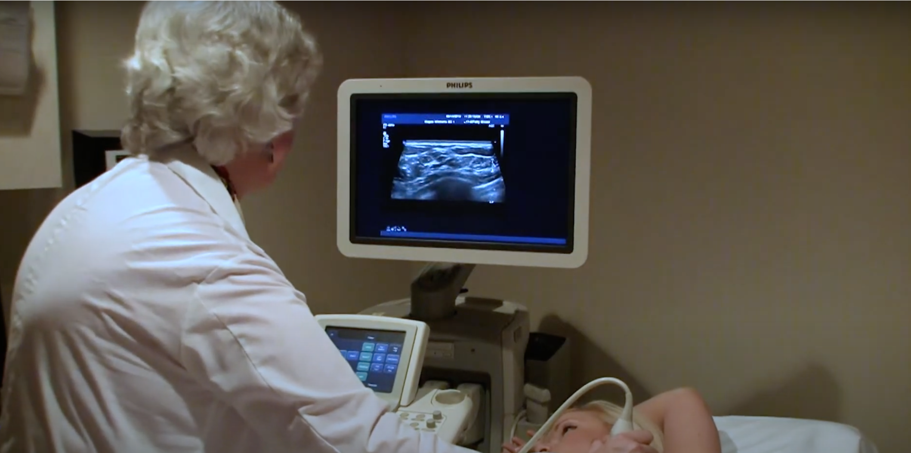
Automatic breast lesion segmentation in ultrasound images
Jenish Rudani
ensc895

Slide 2
Outline
Introduction
Problem Definition
Proposed Solution
Algorithm
Results
REMAINING WORK
References

Slide 3
INTRODUCTION
BREAST LESION SEGMENTATION
MAMOGRAPHY
ULTRASOUND IMAGING
MAGNETIC RESONANCE IMAGE

Slide 4
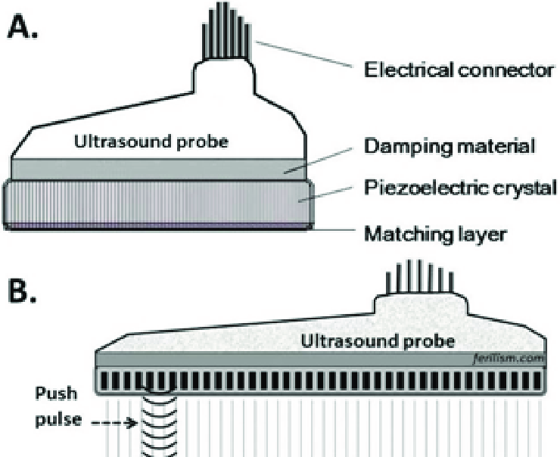
INTRODUCTION CONT.
Commonly used as a complementary imaging test
Targets specific areas within the breast
Transducer

Slide 5
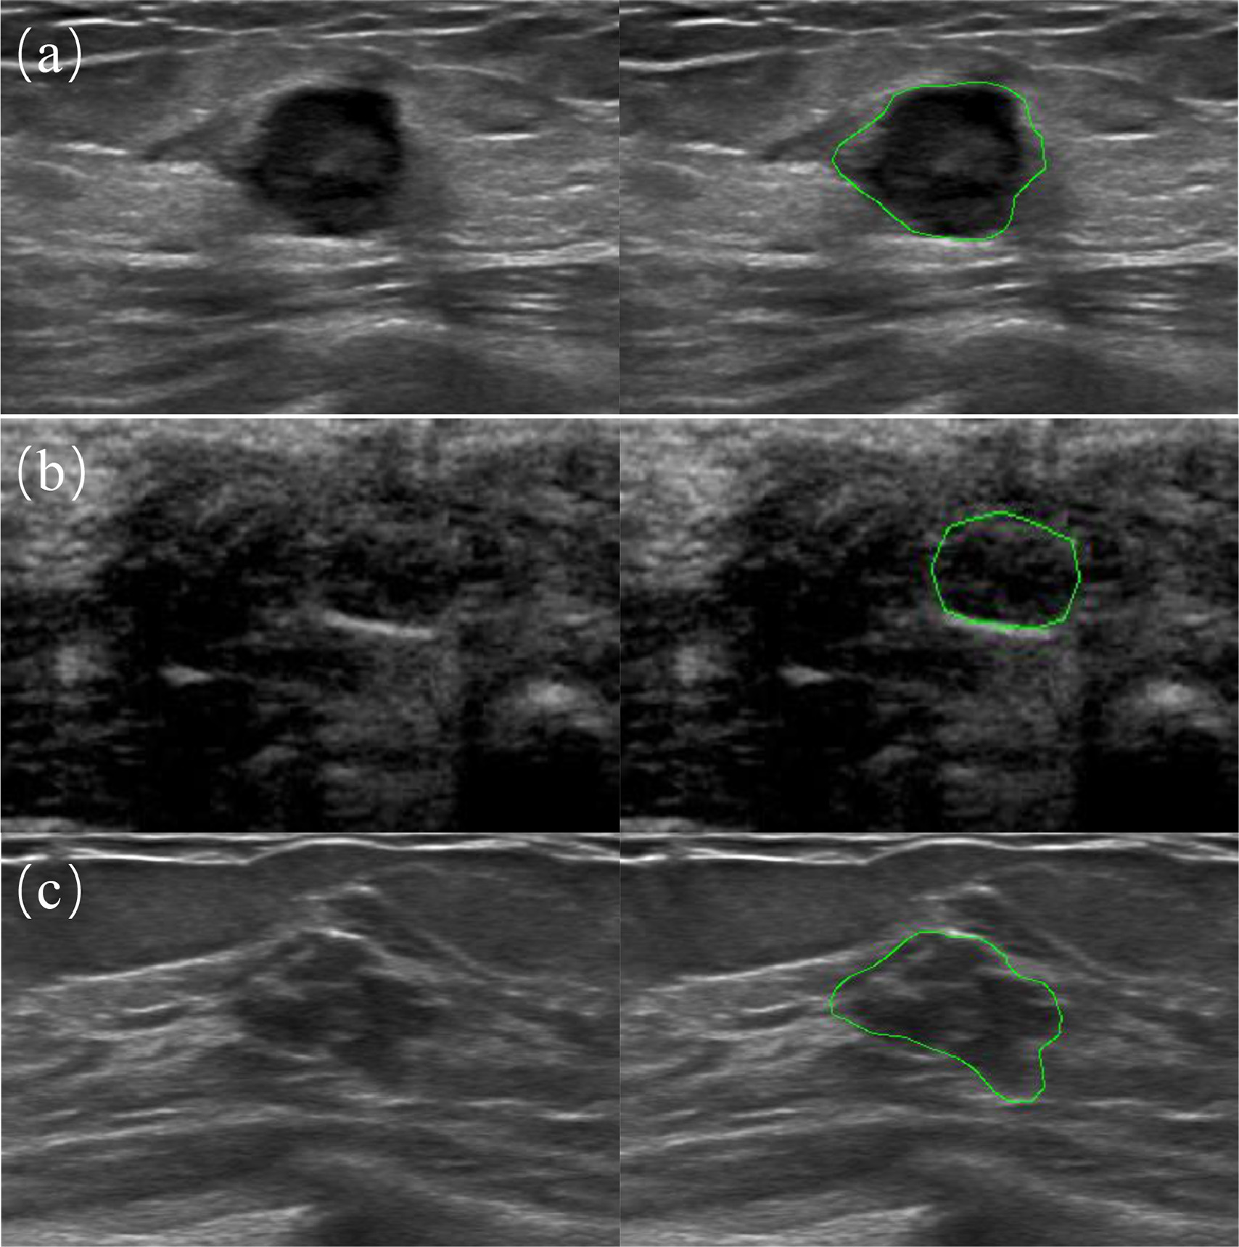
Problem Definition
Examples of challenging cases in breast ultrasound lesion segmentation. The green contour denotes the breast lesion boundary.
Left : The input US Images.
Right : The lesion region.
(a) Non-Uniform distributions inside the breast lesion region. (b) Ambiguous boundary due to similar appearance between lesion regions and non-lesion backgrounds. (c) Varying Irregular breast lesion shapes in BUS Images

Slide 6
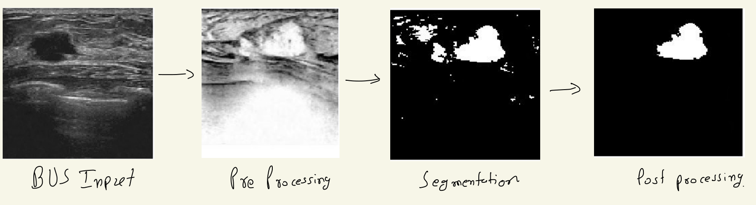
Proposed Solution
Preprocessing
Contrast Stretching
Segmentation
Quick Shift
Post Processing
Normalization and Thresholding
Results
Image Union Provided GT
Negative Image
Speckle Removal
Normalization and Thresholding
Image Union GT produced by algorithm

Slide 7
Algorithm
Global Histogram Equalization
Speckle(interference) Removal (not a noise)
Why Speckle in BUS?
What is the Aperture?
Normalization to achieve consistency in dynamic range for a set of BUS Images
Segmentation Algorithm
Post processing binary thresholding
Results Comparison

Slide 8
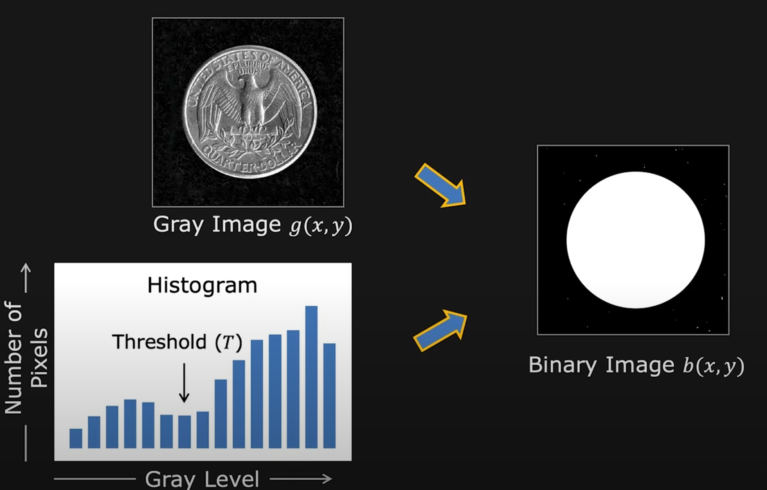
Algorithm Cont. (Segmentation)
Binary Segmentation
Active Contour

Slide 9
Algorithm Cont.
Top-Down Segmentation : Set of pixels belong together because they come from same object
Bottom-up Segmentation : Set of pixels belong together because they look similar
K Means
Issue 1: Specify Number of segment (which can be arbitary)
Issue 2: Arbitrary Initialization Issue
Mean Shift
Simple but computationally expensive O(N²), and sensitive to window size, but finds arbitrary # of seg, no initialization, robust to outliers
Graph Cut

Slide 10
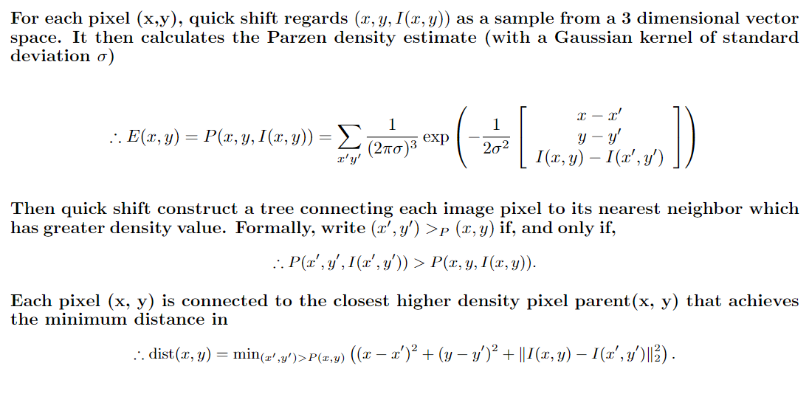
Algorithm Cont. (Quick Shift)

Slide 11
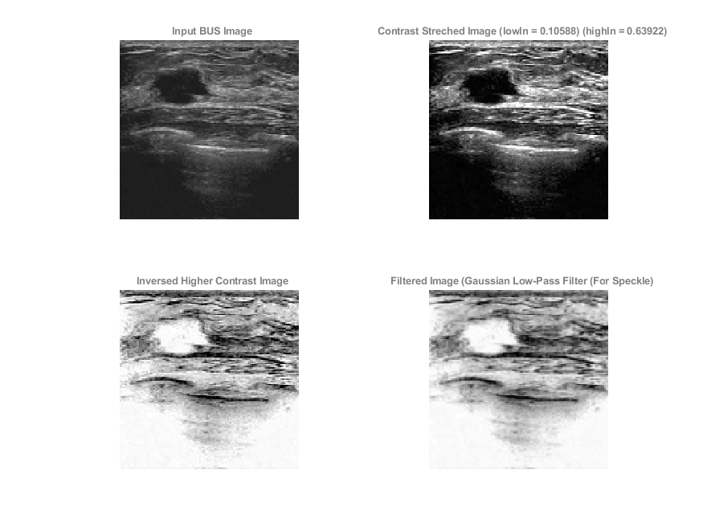
RESULTS

Slide 12
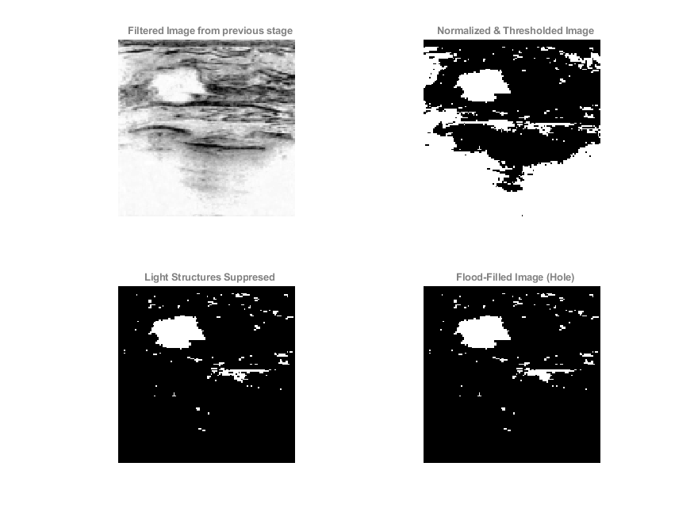
RESULTS

Slide 13
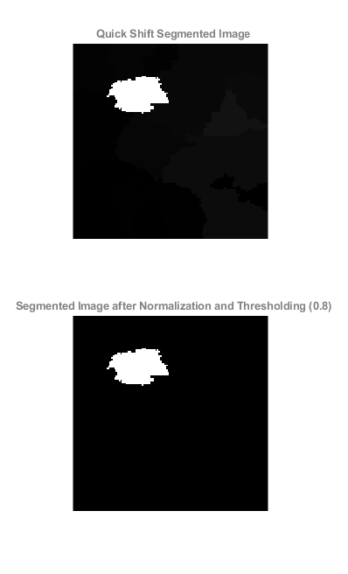
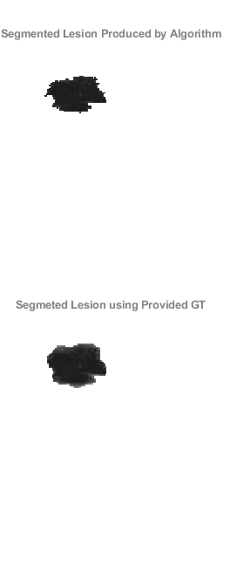
RESULTS

Slide 14
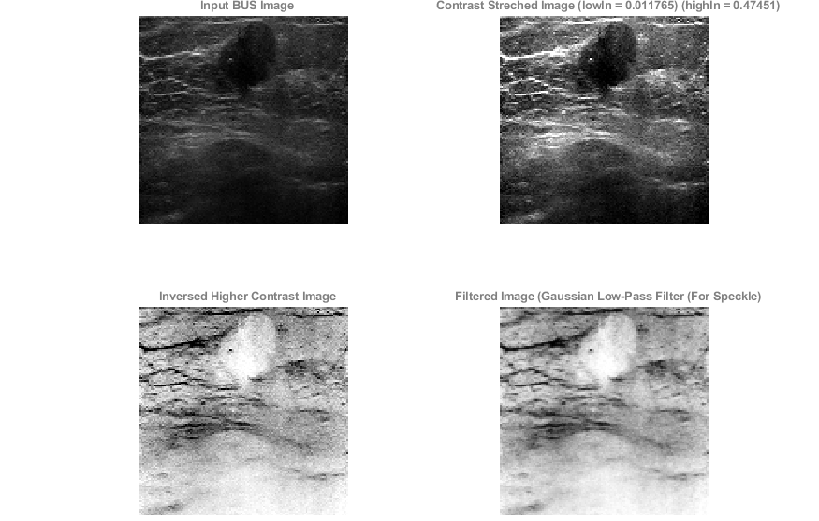
RESULTS

Slide 15
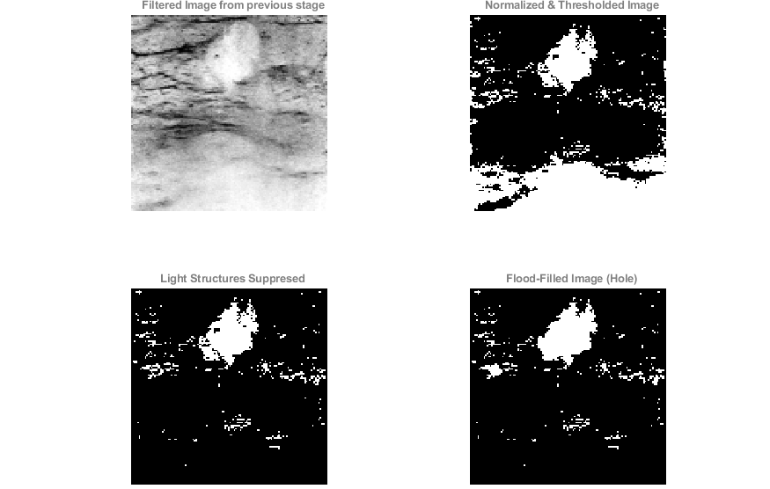
RESULTS

Slide 16
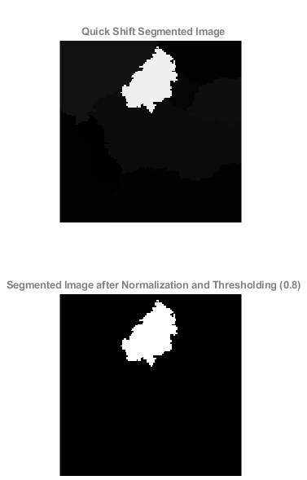
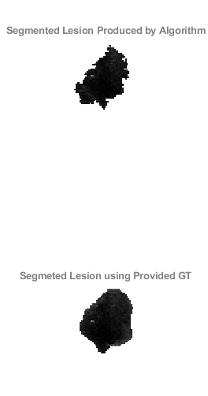
RESULTS

Slide 17
REMAINING WORK
Statistics (JI, DCS)
Better Comparison (Intersection over Union)

Slide 18
References
Vedaldi, A., Soatto, S.: Quick shift and kernel methods for mode seeking. In: European Conference on Computer Vision (2008)
Cheng Xue, Lei Zhu, Huazhu Fu, Xiaowei Hu, Xiaomeng Li, Hai Zhang, Pheng-Ann Heng, Global guidance network for breast lesion segmentation in ultrasound images, Medical Image Analysis, Volume 70, 2021, 101989, ISSN 1361-8415 LINK
https://rdcu.be/cKnma
https://fpcv.cs.columbia.edu/
https://www.vlfeat.org/overview/tut.html

